Slide 1
Welcome to the Math Center
FALL 2023

Slide 2
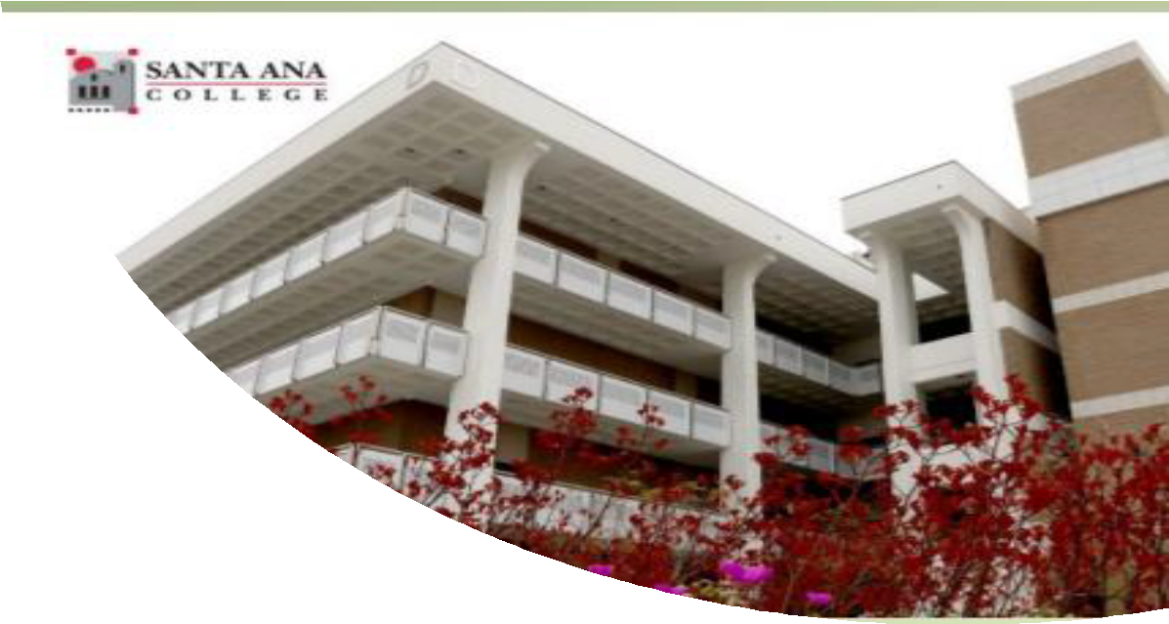
Access to In-person or
Online Tutoring by:
Registering to LRN 095 through Self-Service
Registration is required by all students who wish to use tutoring services

Slide 3
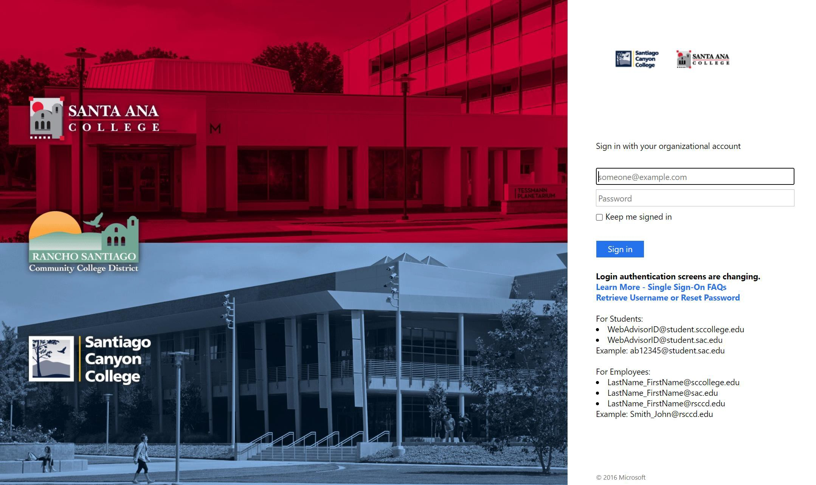
1. Log in to Self-Service with your Student Credentials.

Slide 4
2. Under Home screen, click ‘Student Planning’

Slide 5
3. On the search bar, type in section number “33597”. Then click on ‘Magnifier’ symbol.

Slide 6
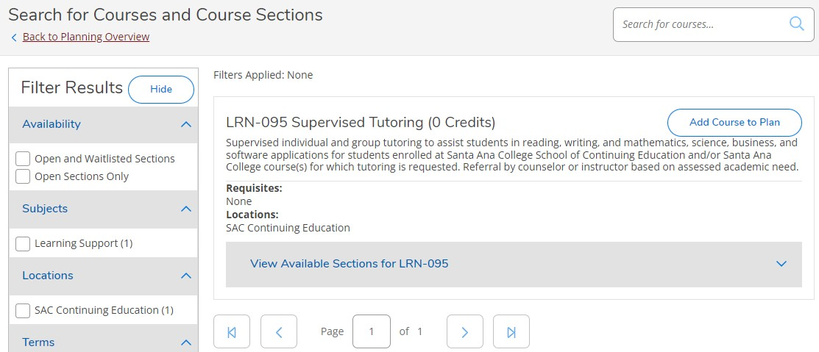
4. Click on ‘View Available Section for
LRN-95’.

Slide 7
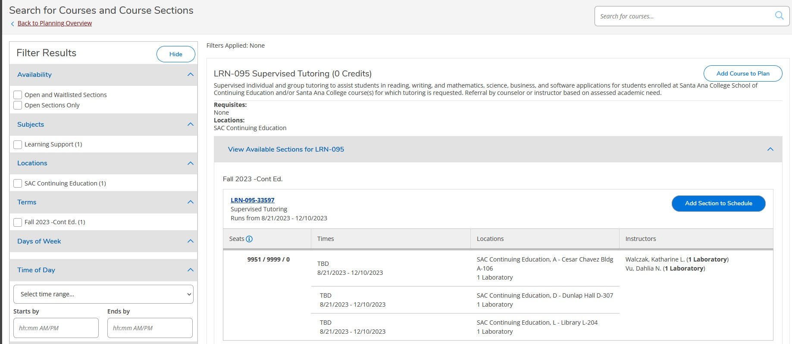
5. Click on ‘Add Section to Schedule’.

Slide 8
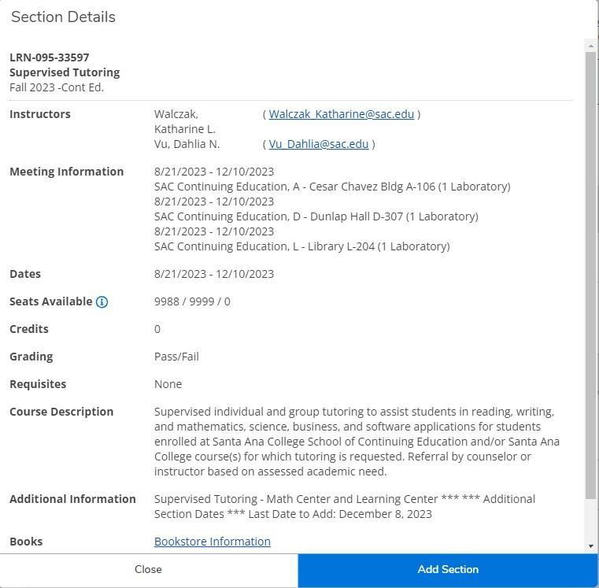
6. Verify information as shown below. Then,
click ‘Add Section’.

Slide 9
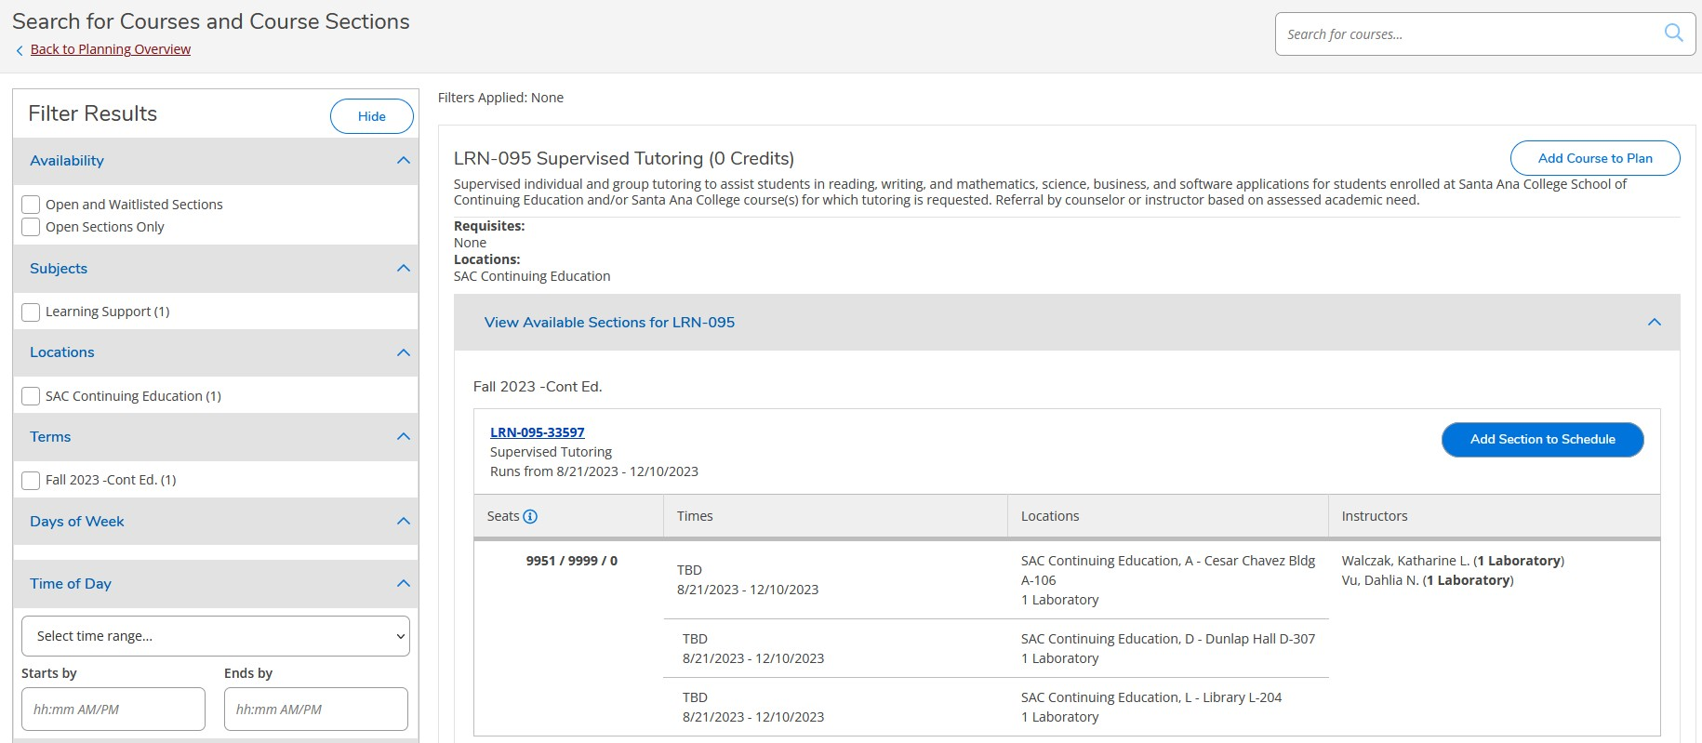
7. Click ‘Back to Plan & Schedule’.

Slide 10
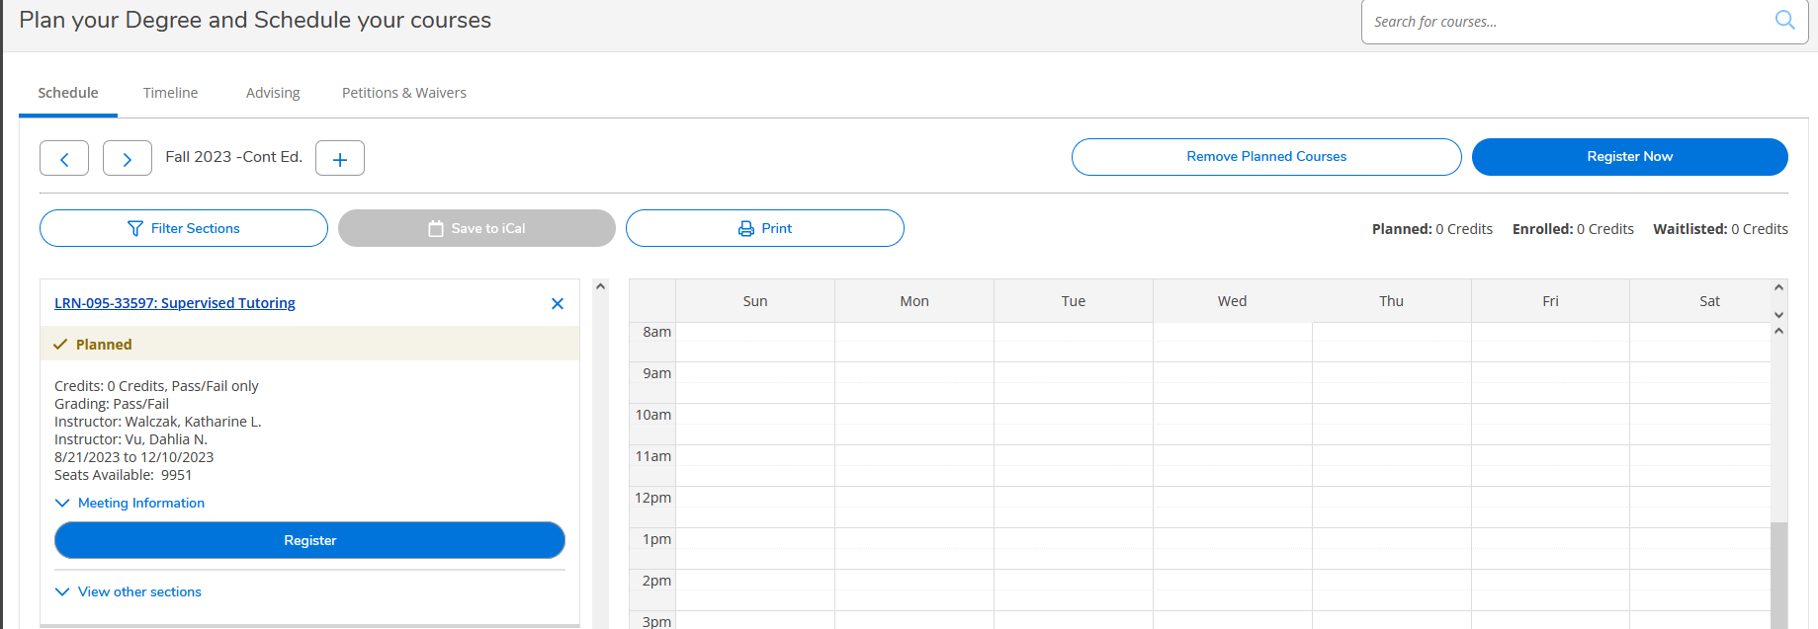
8. Click ‘Register Now’ or click ‘Register’

Slide 11
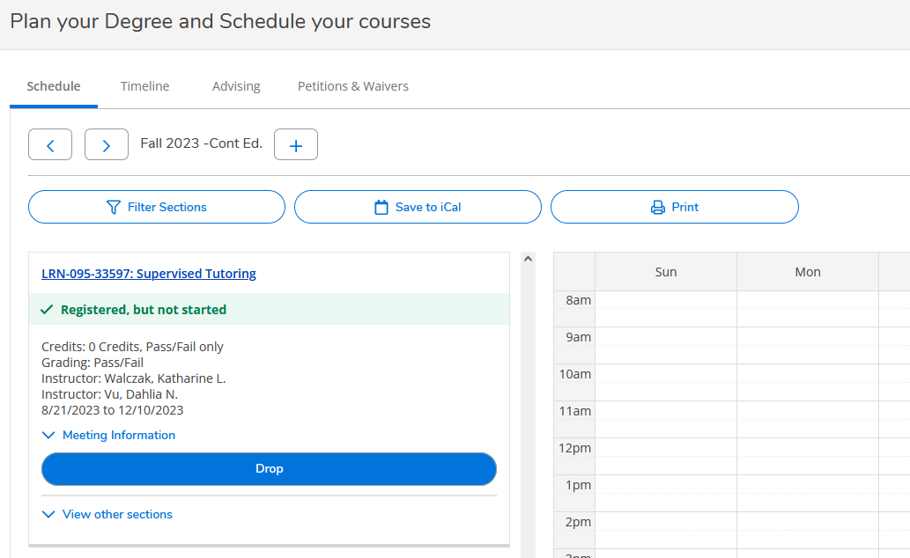
You are now successfully registered
for the Math Center

